Slide 1



Bringing your central CERT closer
23rd September 2021
David Thejl-Clayton

Slide 2
Introduction to this talk…
Introductions
Myself
Combitech
The current situation
The Problem
Possible solution

Slide 3




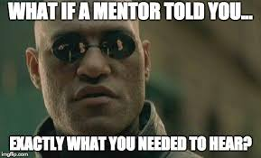
A little about Me…
British living in Denmark
Senior Advisor
Blogger
Open source
Teaching/Mentoring

Slide 4





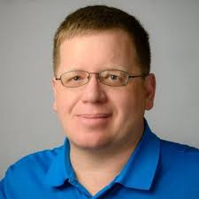
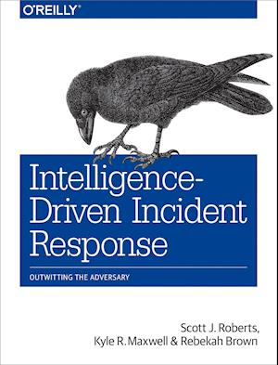
My life in CTI
Intelligence Driven
2017
2018
2019
2020
2020
2021
IOC’s, Threat feeds, Automation
Threat Intelligence Committee
Moved to Combitech

Slide 5




Combitechs forretningsprofil
Nordisk leder indenfor IT-sikkerhed
Combitech er med sine 2000 medarbejdere, heraf 300 dedikerede IT-sikkerhedsspecialister, Nordens største uvildige konsulentvirksomhed på IT-sikkerhedsområdet og leverer uvildig rådgivning med dyb sektorviden og sektorspecifikke services.
Sikkerhed er i vores DNA Combitech er en uvildig og uafhængig del af Forsvars- og Sikkerhedsindustrien Saab AB og vores forankring i forsvarsindustrien betyder, at vi har unikke kompetencer indenfor bl.a. Threat Intelligence sikring af kritisk infrastruktur.
Vi har stor erfaring med udarbejdelse af komplekse IT-sikkerhedsprogrammer og med rådgivning indenfor sektorfokuserede og -specialiserede IT-sikkerhedsområder, hvor specifikke krav skal implementeres ud fra best-practice guidelines og regulatoriske krav for den enkelte sektor.
Sikkerhed med et formål
Vores mål er at etablere partnerskaber med vores kunder og hjælpe med at sikre et risikobaseret og modstandsdygtigt it-sikkerheds set-up på tværs af virksomheden. Vi har ansat dedikerede sektoreksperter med mange års erfaring på topledelsesniveau for at sikre, at vi kan binde IT-sikkerhed og forretnings sammen.
Best in Class kompetencer
Vi vil være bedst – og vi tilbyder en høj leverancekapacitet, en bred palette af specialistkompetencer og best-in-class leverancekvalitet. Alle Combitechs medarbejdere bliver ved ansættelsen sikkerhedsgodkendt af Forsvarets Efterretningstjeneste (FE) samt af Saab Group interne sikkerhedsafdeling. Vi er certificerede inden for ISO 27001, ISO 9001 samt ISO17025 og vores medarbejdere har certificeringer indenfor: CISM, CRISC, CISA, CIPT, CIPM, CIPP/E, CISSP, CCSP, OSCP, OSCE
27005
EN BETROET PARTNER
IT-SIKKERHED
AS-A-SERVICE
NORDISK LEDER I IT-SIKKERHED
Combitech er en betroet samarbejdspartner for virksomheder af alle størrelser på tværs af flere sektorer
Combitech tilbyder IT-sikkerhed som en service – en moderne, kontrolleret og nem måde at sikre virksomheder på
Med mere end 300 konsulenter er Combitech Nordens største leverandør af uvildig rådgivning på IT-sikkerhedsområdet

Slide 6
My life at Combitech
Purple Teaming
CTI
Incident Response
Detection Engineering
TIBER
Advisory

Slide 7

My reason for presenting today
I am not affliliated with NFCert
But I have their approval to talk about this
I used to sit on the TIC (Threat Intelligence Committee) on behalf of JN Data
Everyday I saw this gap and it frustrated me...

Slide 8

bring your central cert closer?
First off who is the central CERT in Finance?
Nordic Financial CERT
So how can we bring them closer?
Aren’t we already close enough?

Slide 9

Maturity in the finance sector
The finance sector has been leading the way in its adoption of cyber threat intelligence:-
TIBER
Threat Intelligence Committee at NFCert
MISP
And more...

Slide 10
MISP
Originally a NATO built tool
Now run at CIRCL in Luxembourg
Open source
Defacto standard for threat intelligence sharing
Widespread adoption across the sector

Slide 11
Threat sharing with MISP
Org A
Org B
Event: Qbot infection
Payload hash: XXX
IP Address of C2: XXX
Event: Qbot infection
Payload hash: XXX
IP Address of C2: XXX

Slide 12
Threat sharing with NFCert
NFCert
NFCert operates as a clearing house
Facilitating sharing through themselves
Big benefit:-
Individual members don’t need to setup MISP sharing between them
Org A
Org B

Slide 13
This is great David, where is the problem?

Slide 14

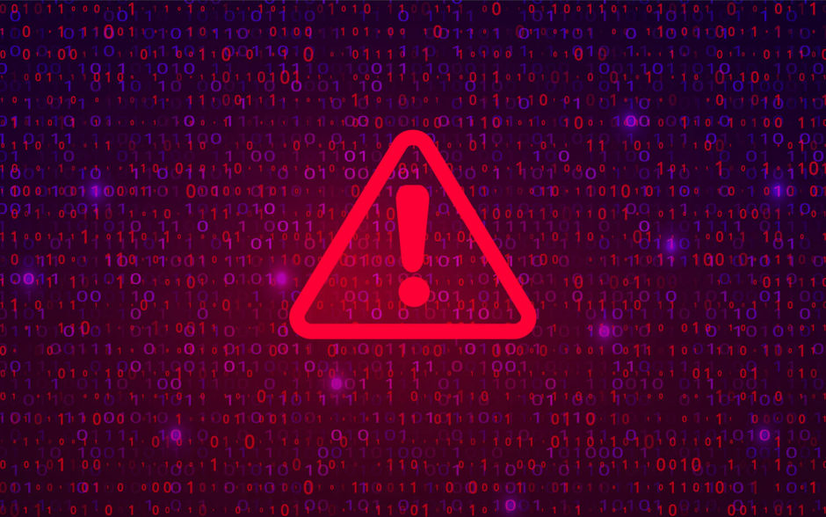
Automation... To a point...
Manual update if seen?
Indicators published in MISP
Decision?
How to use this?
Cyber attack in sector
0
1
2
3
4
5
Receive intel
Arrives in constituents
Indicators added to prevention or detection

Slide 15
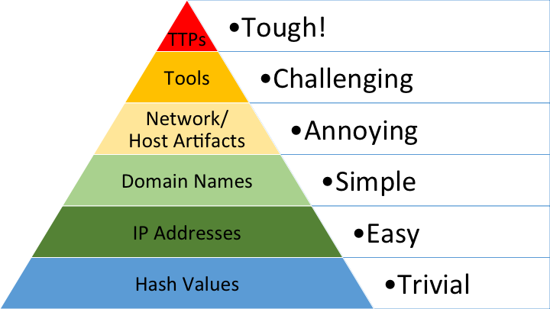
The problem
For the last few years the focus has been on improving detection higher up the pyramid.
But if this is the case, why is there only indicators being exchanged via MISP?
Indicators decay...
Source: The Pyramid of Pain | Enterprise Detection & Response (detect-respond.blogspot.com)

Slide 16
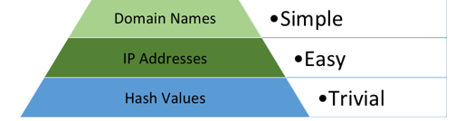
The Decaying indicator
Attackers change infrastructure quickly
CIRCL have created some data science around how fast indicators decay
Simplified graph…

Slide 17
Ok but still where is the issue?

Slide 18
Decay -----> Missed opportunity
We haven’t seen this attack
Indicators published in MISP
Decision?
How to use this?
Cyber attack in sector
0
1
2
3
4
5
Receive intel
Arrives in constituents
Organization ransomed
Attacker changes infrastructure

Slide 19
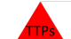
Is automation really the key?
We don’t just need automation
It needs to evolve a bit further than simple indicator sharing
What about sharing detections, which focus on the top of the pyramid?

Slide 20


The deeper problem
NFCert
If NFCert need to send detections to their constituents:-
Each organization has their own SIEM
Does NFCert need to send detections in every SIEM language?
There are a lot…
Org A
Org B

Slide 21

There is some salvation…
The security community saw the need to be able to share common detection rules across the industry...
Sigma was born
Generic detection language
Sigma converter tools
Uncoder.io and more…

Slide 22
The solution…
We are back at the gap…
At this time:-
I had a great intern Michael Pedersen
Now employed at JN Data CDC
We hypothesized that it could be possible to use MISP to solve this problem

Slide 23
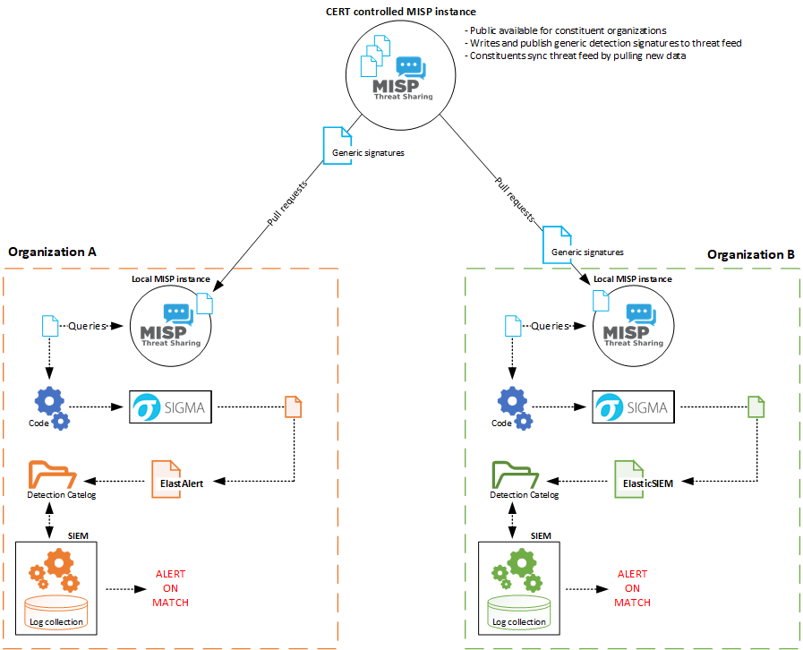
This is his internship project
…Simple right?

Slide 24
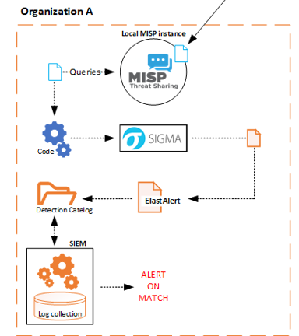
So what is actually happening here?
The detection comes in via the connection to the NFCert MISP
A small piece of code monitors MISP for new detections
When a new detection is published, the code interacts with the Sigma translator
The translated detection is pushed into the SIEM engine via API

Slide 25
This all sounds great… What else?
Benefits
Considerations
NFCert can begin to run automated detections directly into their constituents MISP
Move higher up the pyramid of pain
It can be tweaked to allow NFCert to threat hunt
Governance is required around which log sources should be allowed to be queried
Could this be used by CFCS as a way of supplementing their sensor network?
Combitech do this today with our customers…

Slide 26













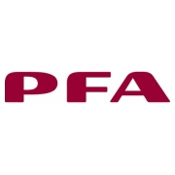



















kundeportefølje
COMBITECH.DK | .SE | .FI | .COM

